Slide 1
Biodiversity capstone project
Codecademy Data Analysis intensive course

Slide 2
Objective
The National Parks Service would like to perform some analysis on the conservation statuses of the species in their care to identify whether certain species are more likely to become endangered.
Track the movement of sheep across several national parks--where are they most likely to be spotted?
Park Rangers at Yellowstone National Park have been running a program to reduce the rate of foot and mouth disease at that park. The scientists want to test whether or not this program is working. They want to be able to detect reductions of at least 5 percentage points.

Slide 3
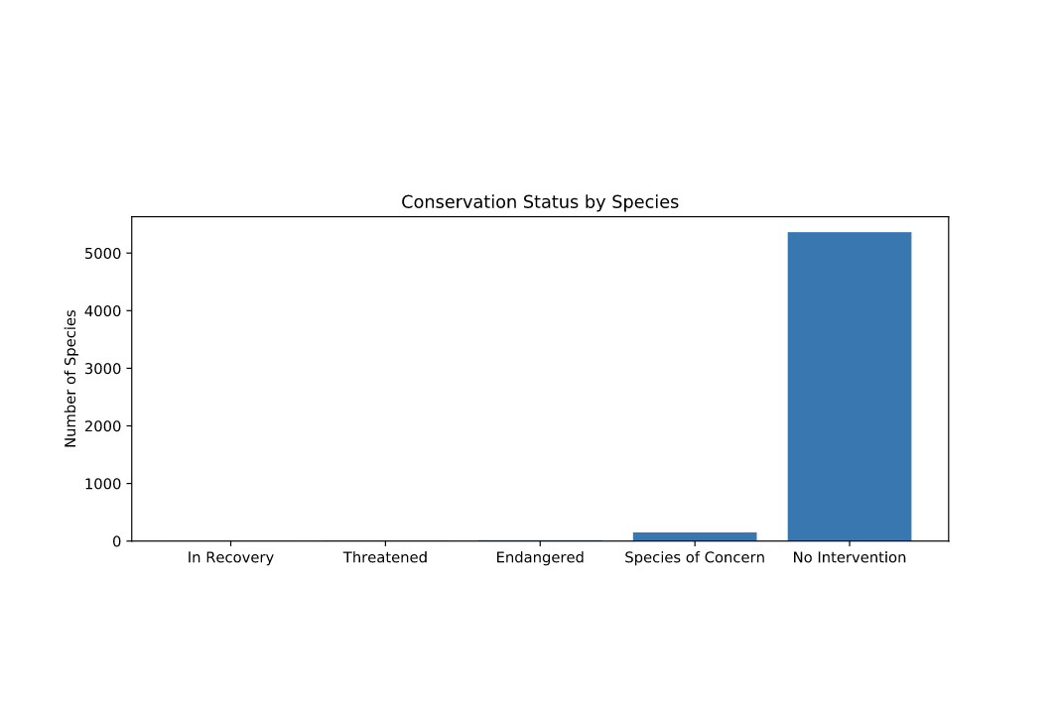
Likelihood of becoming endangered
The majority of species don’t require any intervention.
There was a slight difference in the percentages of birds and mammals that fall into a protected category, but after running the chi-squared test, the p-value was ~0.68, so the difference is not significant
The difference of percentages of protected reptiles and mammals was significant, however. (p-value was ~0.038).

Slide 4
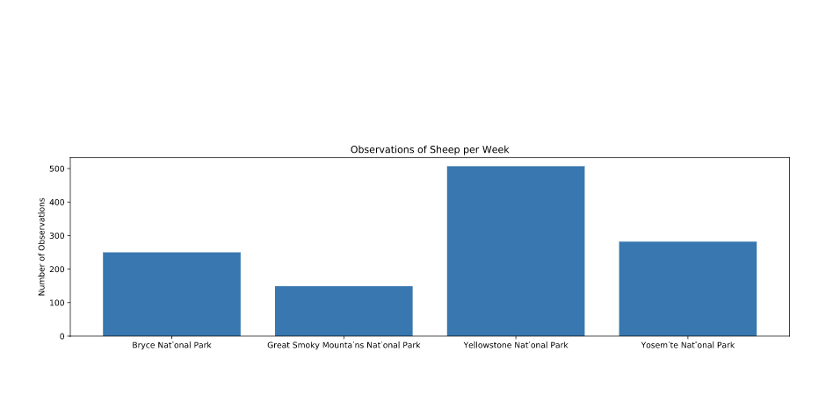
Spotting the sheep and disease reduction
Scientists are more likely to spot sheep at Yellowstone national Park
Taking into account a baseline of 15% occurrence of foot and mouth disease in sheep at Bryce National Park, for scientists wanted to be sure that a >5% drop in observed cases of the disease in the sheep at Yellowstone was significant they would have to observe at least 510 sheep.

Slide 5
Recommendations
Based on the chi-squared test, can conclude that certain types of species are more likely to be endangered than others.
For the scientists to spot a significant amount of sheep at the Yellowstone National Park, they would need to engage in approximately one week of observing, or approximately two weeks in Bryce National Park to see that many sheep.

